Slide 1
Blink Delivery
Online groceries system- MYSQL Project
Priscila Boada
04/01/2022

Slide 2
Database
Unique value Columns:8
Rows: 8404

Slide 3
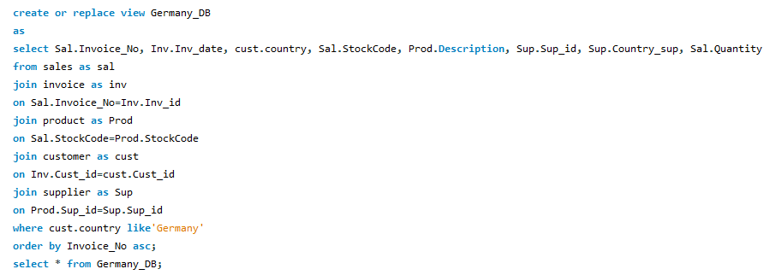
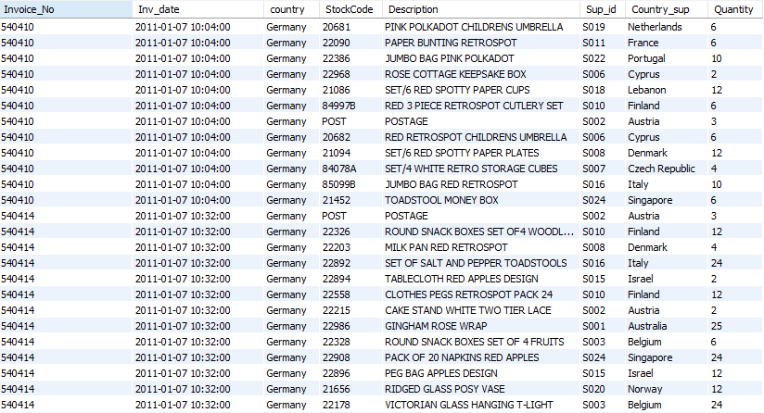
1. Using any type of the joins create a view that combines multiple tables in a logical way
The view generated is a simulation of the information available for Germany
Code
Result

Slide 4
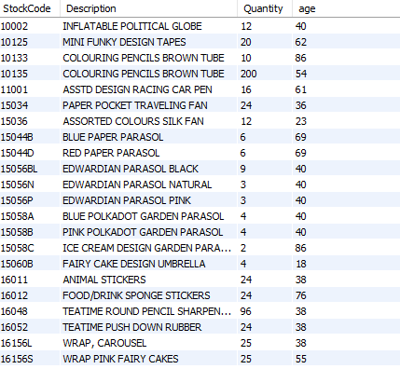
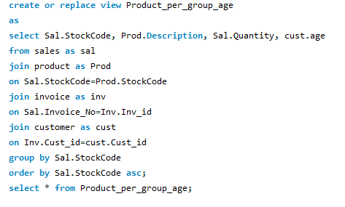
2. In your database, create a stored function that can be applied to a query in your DB
Result
I am generating a view that contains the products and its quantity group by customer age
(This could allow me to target the products according to the customer age group)

Slide 5
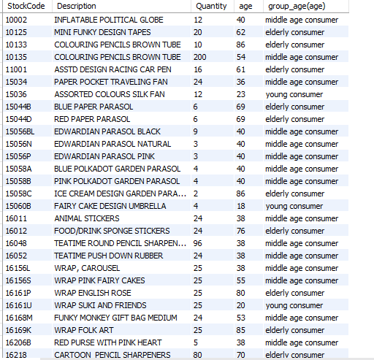
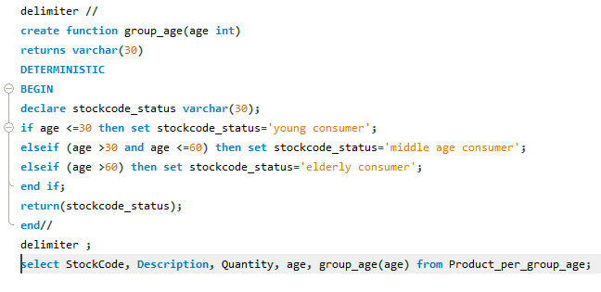
Function code
Result

Slide 6
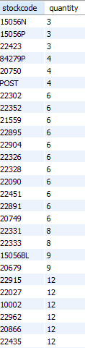

3. Prepare an example query with a subquery to demonstrate how to extract data from your DB for analysis
result
Find the stockcode and quantity of each sale where the customer is a Female

Slide 7
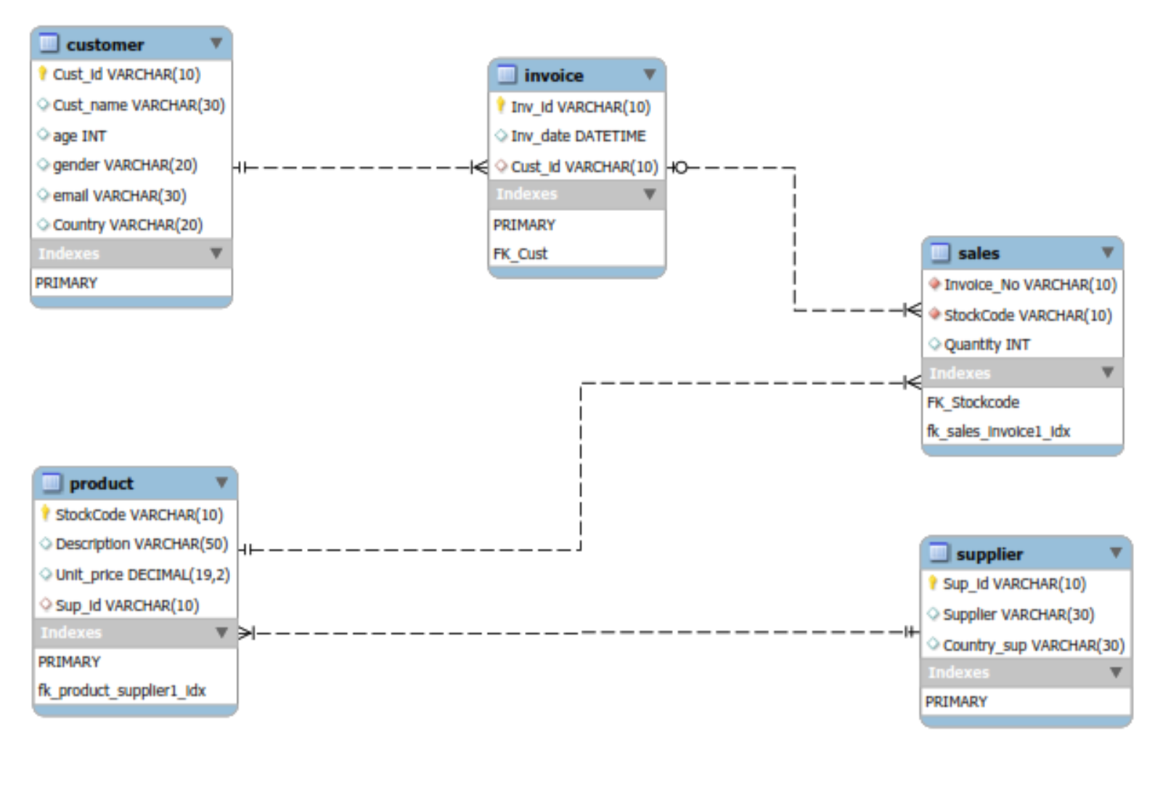
4. Create DB diagram where all table relations are shown

Slide 8
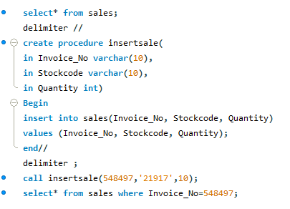

ADVANCED OPTIONS 1. In your database, create a stored procedure and demonstrate how it runs
Code
This procedure inserts new invoices into the table sales
Result

Slide 9
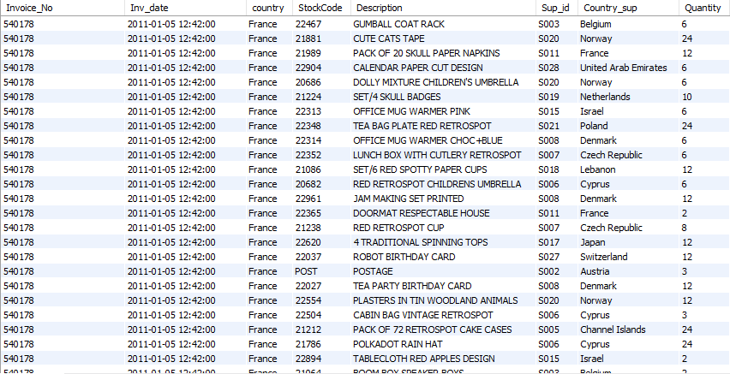
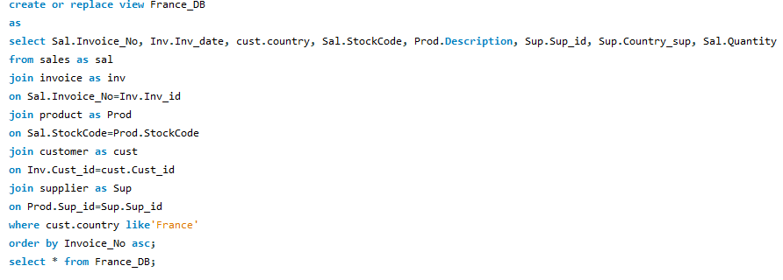
2. Create a view that uses at least 3-4 base tables; prepare and demonstrate --
Result France_DB
create or replace view France_DB

Slide 10
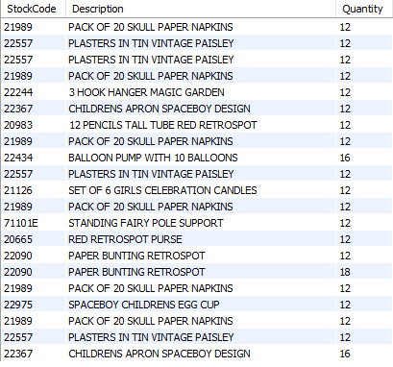

query that uses the view to produce a logically arranged result set for analysis.
Query: Find out the Stockcode, description and quantity of products provided by a France Supplier that have a quantity bigger than 10 and smaller or equal than 20
Result

Slide 11
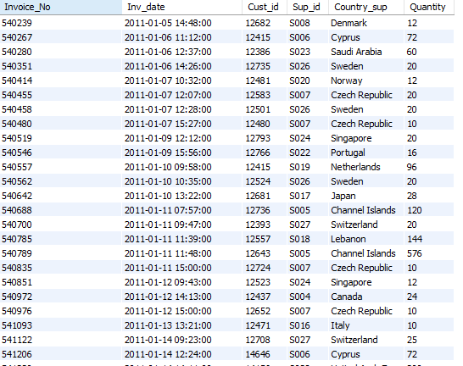
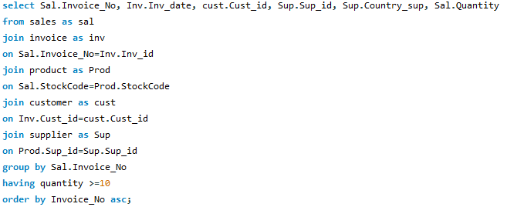
3. Prepare an example query with group by and having to demonstrate how to extract data from your DB for analysis
Define the Invoice_No, Inv_date, Cust_id, Sup_id, Country_sup for all the invoice having more than 10 products sold

Slide 12
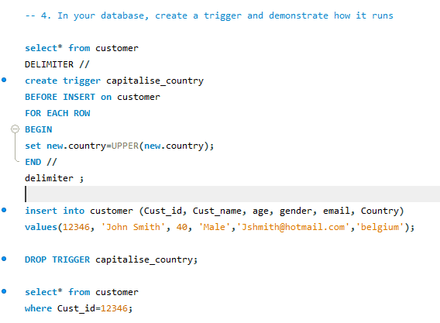

4. In your database, create a trigger and demonstrate how it runs
Code
Result

Slide 13
Thank you!
Questions and Answers

